Slide 1

Paul meier
Syeda ismat farjana
CODER ACADEMY
JS HACKATHON
PAIR PROGRAMMER

Slide 2

WHAT IS
PAIR PROGRAMMER
A VANILLA JAVASCRIPT APPLICATION TO RANDOMLY PAIR UP STUDENTS IN A CAMPUS

Slide 3

WHY DO WE NEED PAIR PROGRAMMER
TO SAVE THE WORLD OF CHAOS FROM THE AWKWARDNESS OF CHOOSING PARTNER
WHY MAN WHY?

Slide 4
A QUICK WALK THROUGH
LIVE PAIR PROGRAMMER

Slide 5
DEVELOPMENT STAGES
Primitive stage
Improved stage

Slide 6



TECH STACK
HTML
CSS
JS

Slide 7
TECHNICAL CHALLENGES
TO FIGURE OUT THE JS FUNCTION THAT WILL SHUFFLE AND MAKE THE PAIR

Slide 8
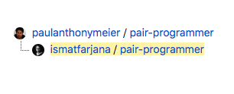
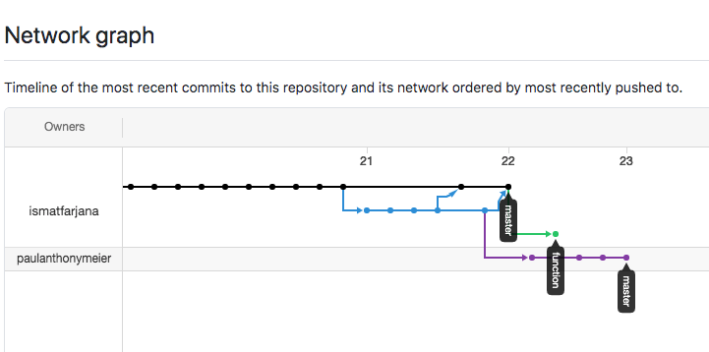
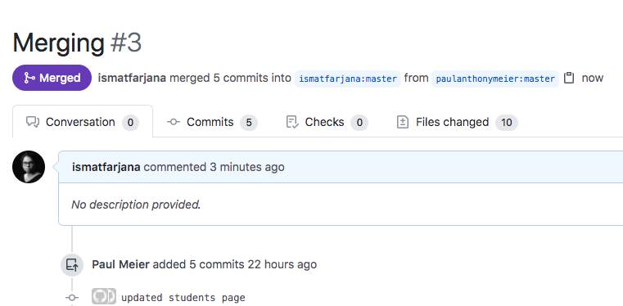
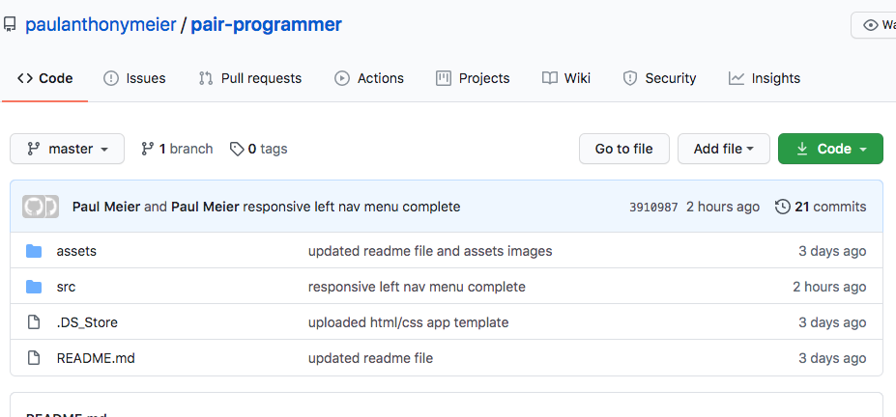
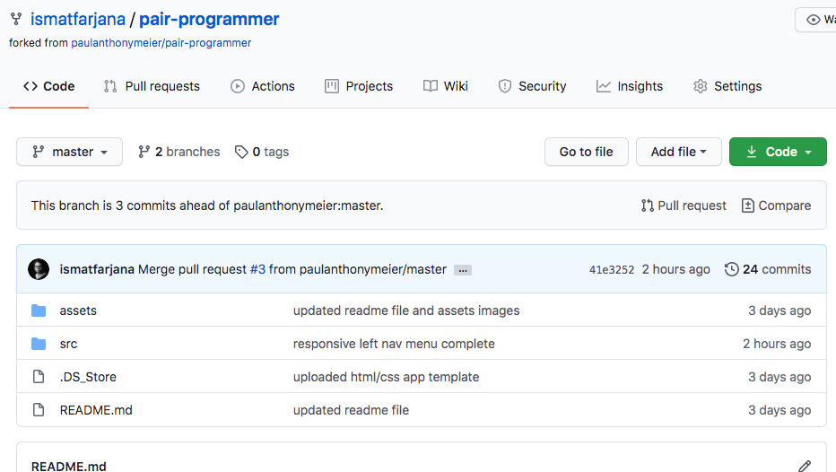
GIT COLLABORATION

Slide 9
FUTURE IMPROVEMENT
ADD CAMPUS
ADD TEACHERS AND STUDENTS PROFILE WITH AUTHENTICATION
STORE INFORMATION USING DATABASE
ADDING FUNCTION FOR THREE OR MORE PERSONS GROUP

Slide 10
THANK YOU

